Slide 1
Career Assistant Program
By: Calvin Mitchell, Danielle Devose, Nathaniel Washington, and Jeremy Metellus

Slide 2
Overall Epics (By First Priority)
01
02
03
04
Secure User Access
Build a secure user authentication system for the app, which includes both the ability for a registered student to log in and for a new visitor to create an account.
Student Profile and Questionnaire
Creating a system that allows students to build and manage their personal profiles. The system will then use this information to personalize recommendations.
Advanced Questionnaire (AI-Assisted)
Designed to guide students through a more detailed assessment. Based on those initial responses, the system then uses Gemini AI to generate a unique set of 8 personalized follow-up questions.
Job Matches and Recommendations
Providing personalized career opportunities to students. It uses a backend API to generate a list of job matches with a relevance score and a reason.

Slide 3
Team Introduction
01
02
03
04
Calvin Product Owner
Danielle
Scrum Master
Jeremy
Developer
Nate
Developer

Slide 4
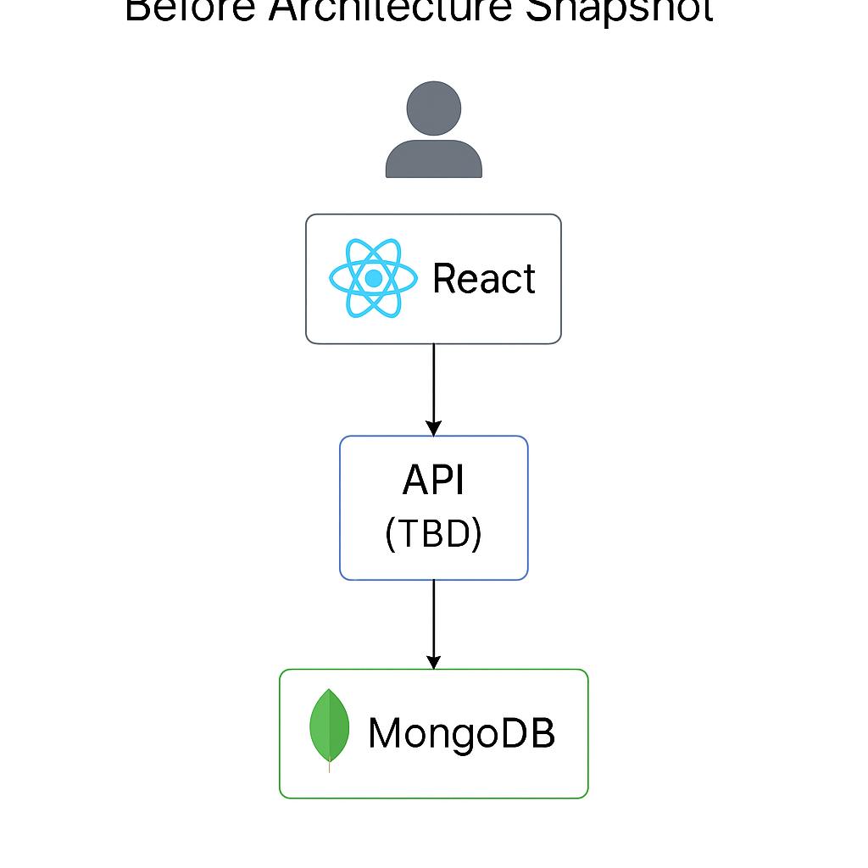
Architecture Snapshot (Before)
Notes:
💻 React (Frontend):
Handles user interface and interaction in the browser.
Communicates with the backend via HTTP requests (e.g., fetch/axios).
⚙️ Express + Node.js (Backend):
Manages routes, APIs, and business logic.
Runs on a Node.js server to process data and send responses.
🗂️ MongoDB (Database):
Stores all persistent data: user profiles, jobs, resumes, applications.
Interacts directly with the backend using Mongoose (or native driver).
🔁 Flow:
User → React → Express/Node → MongoDB → Back to User

Slide 5
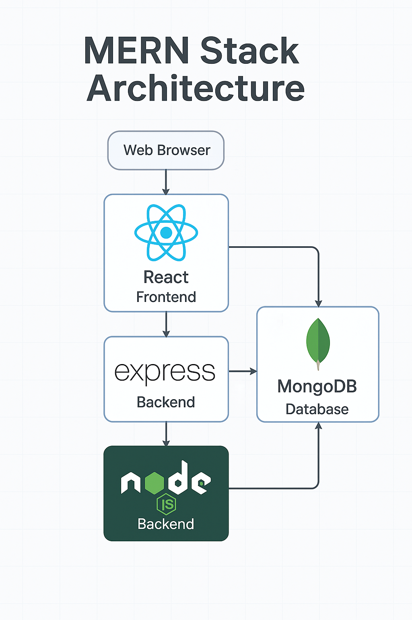
Architecture Snapshot (After)
Notes:
💻 React (Frontend):
Handles user interface and interaction in the browser.
Communicates with the backend via HTTP requests (e.g., fetch/axios).
⚙️ Express + Node.js (Backend):
Manages routes, APIs, and business logic.
Runs on a Node.js server to process data and send responses.
🗂️ MongoDB (Database):
Stores all persistent data: user profiles, jobs, resumes, applications.
Interacts directly with the backend using Mongoose (or native driver).
🔁 Flow:
User → React → Express/Node → MongoDB → Back to User

Slide 6
Links to Demo/Github
Github

Slide 7
Thanks!

